Slide 1

BANGALORE INSTITUTE OF TECHNOLOGY
K.R ROAD, BENGALURU-560074
DEPARTMENT OF INFORMATION SCIENCE AND ENGINEERING
2018-2019
A Project Seminar on
“LSTM Artificial Neural Network Model to Predict Stock Market Investments”
Presented by:
Harshitha.M
4TH Sem, M.Tech
Computer Network Engg
Under the Guidance of:
Mrs Prameela.R
Asst. Professor,
Dept. of ISE,B.I.T

Slide 2
Table of contents
ABSTRACT
INTRODUCTION
OBEJECTIVE
EXISTING SYSTEM
PROPOSED SYSTEM
METHODOLOGIES
CONCLUSION

Slide 3
Abstract
Stock market prediction is the act of trying to determine the future value of a company stock or other financial instrument traded on a financial exchange. The successful prediction of a stock's future price will maximize investor’s gains.A neural networks based model have been used in predicting of the stock market.
Machine learning algorithms will work together and process complex data inputs. A machine learning model to predict Future stock market price of “Apple”.Will use LSTM technique and neural networks to predict the future stock market price of “Apple company”.

Slide 4
Introduction
Data pre-processing is a technique that is used to convert the raw data into a clean data set. In other words, whenever the data is collected from different sources it is in the raw format which is not feasible for the analysis. By using this technique transform the raw data into an understanding format. Real world data is often incomplete, inconsistent and having many errors.
LSTM(LONG SHORT-TERM MEMORY) is an artificial recurrent neural network(RNN) architecture. LSTM networks are well suited to classifying, processing and making predictions based on time series data, since there can be lags of unknown duration between important events in the time series.
Artificial neural networks(ANN) are computing systems inspired by biological neural networks that constitute animal brains. The neural network itself is not an algorithm, but rather an framework for many machine learning algorithms to work together and process complex data inputs.

Slide 5
objective
The main objective to reduce the investment cost unnecessarily.
In those days, people used to invest money of the product and the outcome may not be as expected. So this leads to major drop in the company, whole share will drop down.
To overcome this, predict the future stock market price and then invest accordingly ,which reduces the cost, time and more over enhances the growth of the company.

Slide 6
Existing system
Fundamental analysis
Fundamental Analysts are concerned with the company that underlies the stock itself. They evaluate a company's past performance as well as the credibility of its accounts.
Technical analysis
Technical analysts or chartists are not concerned with any of the company's fundamentals. They seek to determine the future price of a stock based solely on the trends of the past price (a form of time series analysis).
DISADVANTAGES
In those days, people using fundamental and technical analysis to invest money of the product and the outcome may not be as expected . So this leads to major drop in the company, whole share will drop down.

Slide 7
Propoed system
Everything is automated once programmed with combining statitics probability using machine learning.
To predict future development of the profit of the company is totally based on prediction using past data.The data required to input by the company is amount to be invested, minimum proﬁt, maximum proﬁt, maximum loss, and maximum time duration for investment.
From these input parameters and past data set, system designs the strategy for an individual feature.
It uses linear regression and the Long Short Term Memory (LSTM).
ADVANTAGES:
So, by this method using LSTM works to make maximum proﬁt prediction by minimum human intervention

Slide 8
REQUIREMENTS
SOFTWARE
Anaconda navigator as an applications wrapper hub
Spyder as GUI interface for coding
HARDWARE
Processor i3 and above
Ram 4gb and above

Slide 9
SYSTEM DESIGN
Data collection with training and dataset
Min-Max scaling on whole dataset
Fitting and training the model with LSTM
Compare with test data to find out the accuracy based on prediction
Test
Error calculation and finding accuarcy using mean square cross method

Slide 10
Methodologies
Stage 1:
Raw Data: In this stage, the historical stock data is collected from the Google stock price and this historical data is used for the prediction of future stock prices.
Features
TV: Advertising dollars spent on TV for a single product in a given market (in thousands of dollars)
Radio: Advertising dollars spent on Radio
Newspaper: Advertising dollars spent on Newspaper
Sales: Sales of a single product in a given market (in thousands of widgets)
(There are 200 observations, and thus 200 markets in the dataset.)

Slide 11
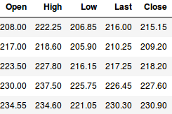
continue
There are four variables in dataset i.e, Open, High, Low, Last and Close.
Open: Opening stock price of the day
Close: Closing stock price of the day
High: Highest stock price of the data
Low: Lowest stock price of the day

Slide 12
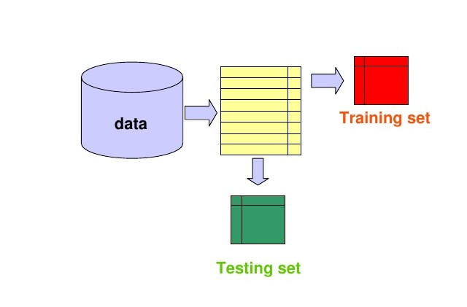
continue
Stage 2: Data Preprocessing: The pre-processing stage involves
Data discretization: Part of data reduction but with particular importance, especially for numerical data
Data transformation: Normalization.
Data cleaning: Fill in missing values.
Data integration: Integration of data files. After the dataset is transformed into a clean dataset, the dataset is divided into training and testing sets so as to evaluate.

Slide 13
continue
Stage 3:
Feature Extraction: In this layer, only the features which are to be fed to the neural network are chosen.
The most basic machine learning algorithm that can be implemented on this data is linear regression. The linear regression model returns an equation that determines the relationship between the independent variables and the dependent variable.
Linear regression formula is Y=a + bX
Where X-Explanatory variable(AD features)
Y-Dependent variable(Sales),The slope of the line is b
a- Is the intercept (the value of y when x = 0).

Slide 14
CONTINUE
Stage 4:
After pre-processing is done, will spilt the dataset in to train set and test set using “minmaxscaler”.
Minmaxscaler goes like this:-
Minmaxscaler is probably the most famous scaling algorithm and follows the following formula:-
(xi–min(x))/(max(x)–min(x))
It essentially shrinks the range such that the range is now between 0 and 1 (or -1 to 1 if there are negative values).This scaler works better for cases in which the standard scaler might not work so well.

Slide 15
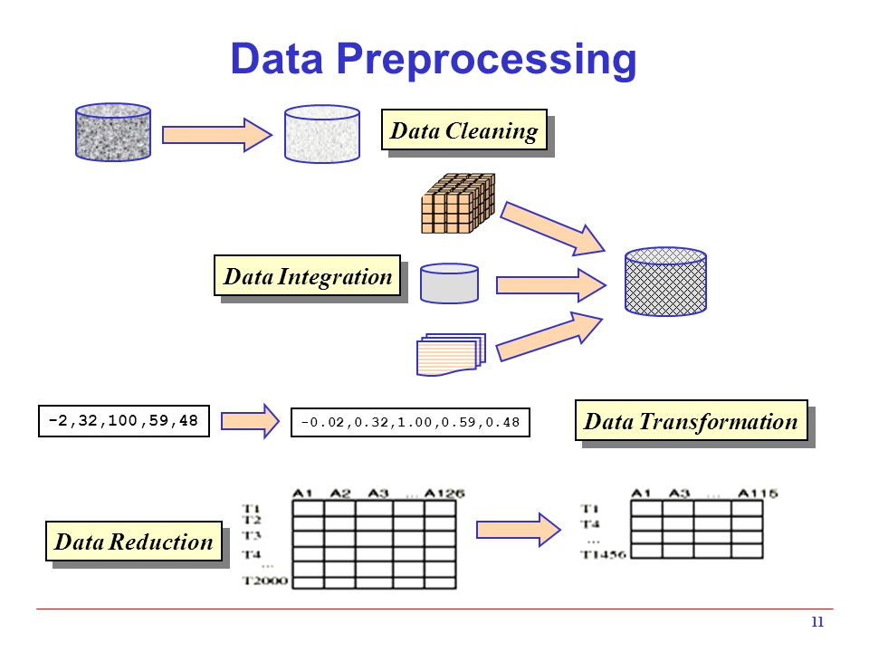
continue

Slide 16
continue
Long Short-Term Memory(LSTM) models are extremely powerful time-series models. They can predict an arbitrary number of steps into the future. An LSTM module (or cell) has 5 essential components which allows it to model both long-term and short-term data.
Cell state (ct) - This represents the internal memory of the cell which stores both short term memory and long-term memories
Hidden state (ht) - This is output state information calculated w.r.t. current input, previous hidden state and current cell input which eventually use to predict the future stock market prices. Additionally, the hidden state can decide to only retrive the short or long-term or both types of memory stored in the cell state to make the next prediction.
Input gate (it) - Decides how much information from current input flows to the cell state

Slide 17
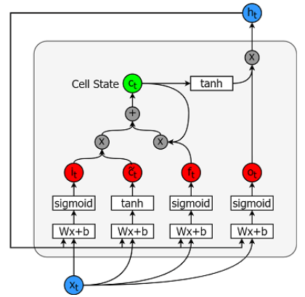
continue
Forget gate (ft) - Decides how much information from the current input and the previous cell state flows into the current cell state
Output gate (ot) - Decides how much information from the current cell state flows into the hidden state, so that if needed LSTM can only pick the long-term memories or short-term memories and long-term memories.
Figure: A cell is pictured

Slide 18
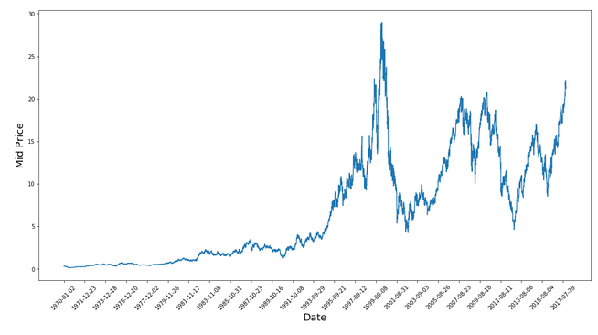
Expected outputs
Figure:Data visualization

Slide 19
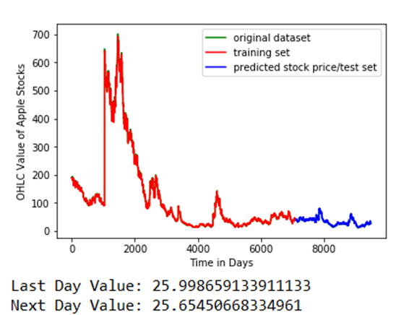
Figure: Final Output

Slide 20
CONCLUSION
By doing data pre-processing we can convert raw data into clean, understandable data and standardized data. It will help for share Holders to predict the future.
We can conclude that using this proposed method and technique can easily and accurately predict the future price of the market with minimizing the human intervention.

Slide 21
THANK YOU

